Slide 1

Readit!
Group Project

Slide 2
Group Roles
D Mac
Sue
Rey
Madison
Alex

Slide 3
Idea/Concept
For people who want a way to keep track of books they want to read
The user can select a book by title or author
The user can save and rate the book once they’ve read it
The user can view online reviews of other readers

Slide 4

Technologies Used
HTML 5
CSS 3
Handlebars
Sequelize
Javascript
Node
API: Google Books
Heroku

Slide 5
Demonstration

Slide 6
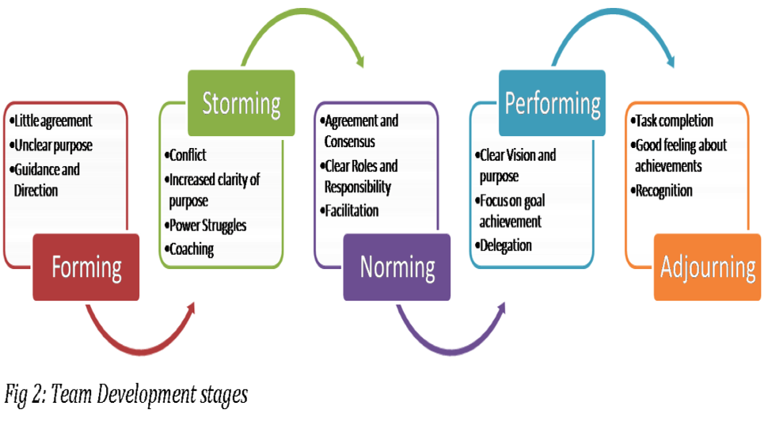
Challenges

Slide 7
Future Modifications

